Slide 1
Image Analysis Update
Shubhom

Slide 2

Average Hashing
Can detect exact duplicates easily
Quick to execute
Requires storing a unique number for each image
Or recomputing the hash for each image within a small radius every time a new image is uploaded
Requires a threshold for non-exact images
May have false positives

Slide 3
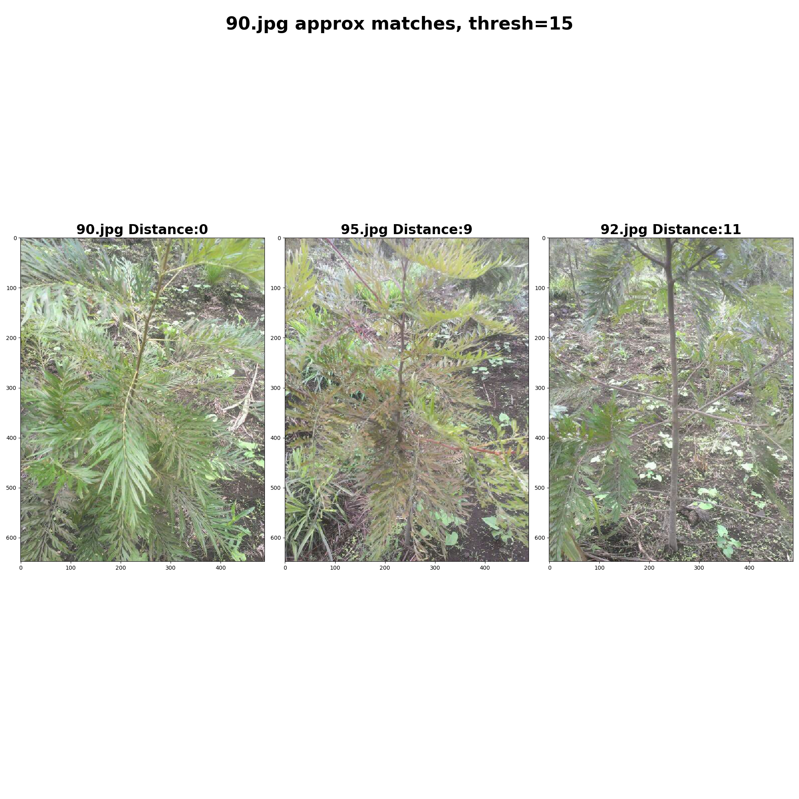
Results
Can always detect exact duplicates
May have false positives

Slide 4
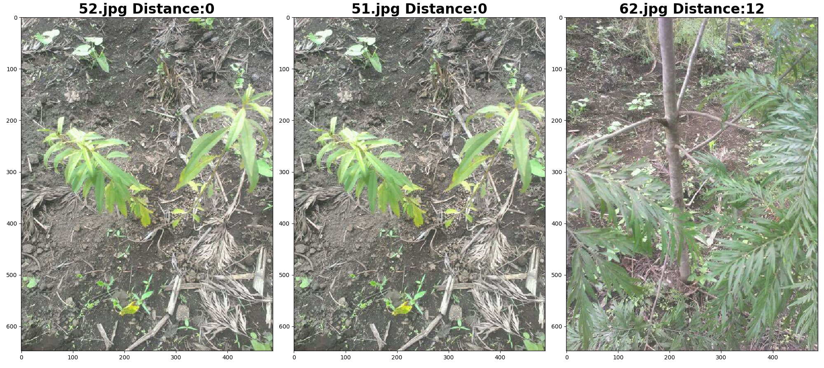
Conclusion:
Hashing is a good first check, but foolable
Threshold should be adjusted to minimize false positives

Slide 5
Histograms
Another useful way to discriminate images based on intensity of pixels rather than distribution
Not computationally expensive either (no complex feature extraction)

Slide 6
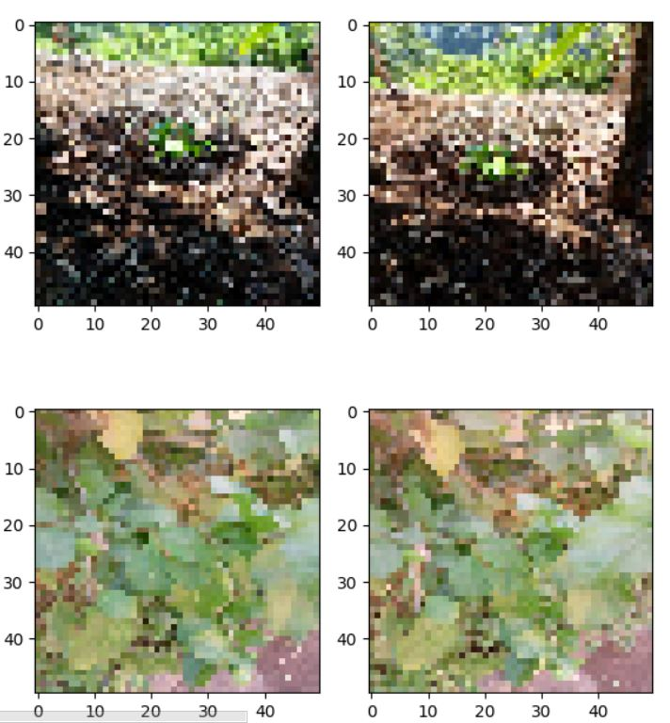
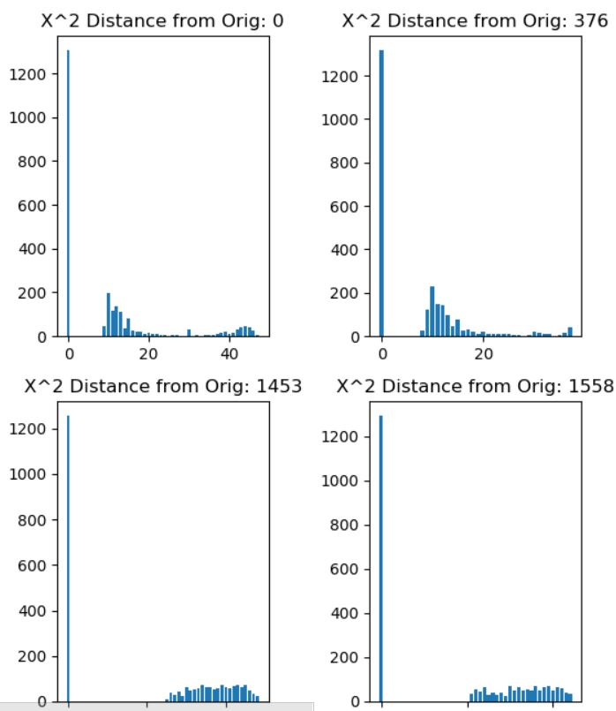
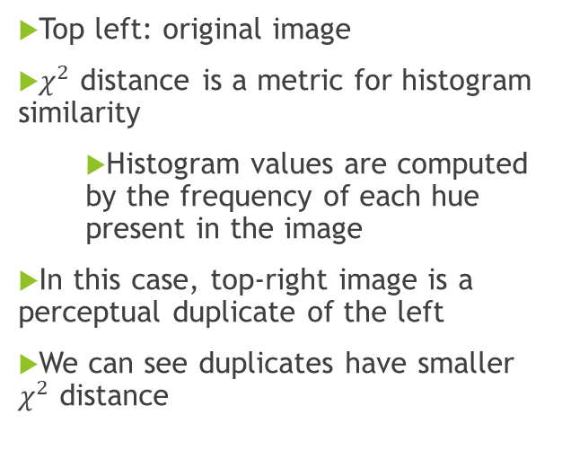
Results
Top left: original image
$χ^{2}$ distance is a metric for histogram similarity
Histogram values are computed by the frequency of each hue present in the image
In this case, top-right image is a perceptual duplicate of the left
We can see duplicates have smaller $χ^{2}$ distance

Slide 7
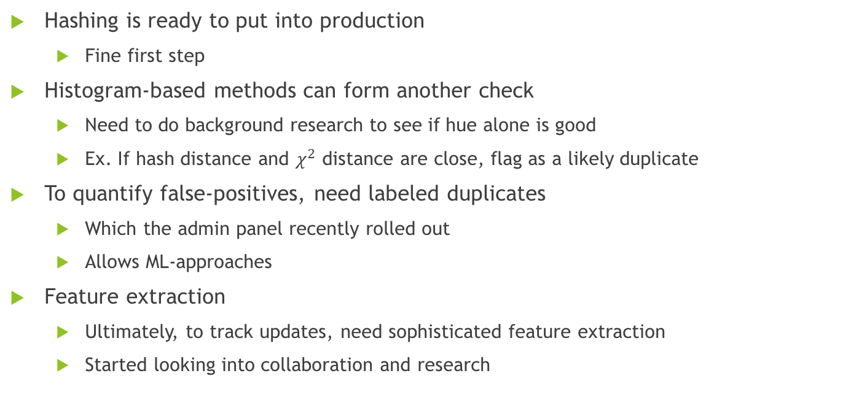
Future Duplicate Work
Hashing is ready to put into production
Fine first step
Histogram-based methods can form another check
Need to do background research to see if hue alone is good
Ex. If hash distance and $χ^{2}$ distance are close, flag as a likely duplicate
To quantify false-positives, need labeled duplicates
Which the admin panel recently rolled out
Allows ML-approaches
Feature extraction
Ultimately, to track updates, need sophisticated feature extraction
Started looking into collaboration and research

Slide 8
Automated Image Quality Analysis
Quick methods to assess image quality
Per pixel variance of image Laplace transform
Histogram comparison of grayscale intensities
Currently both are being tested

